Slide 1
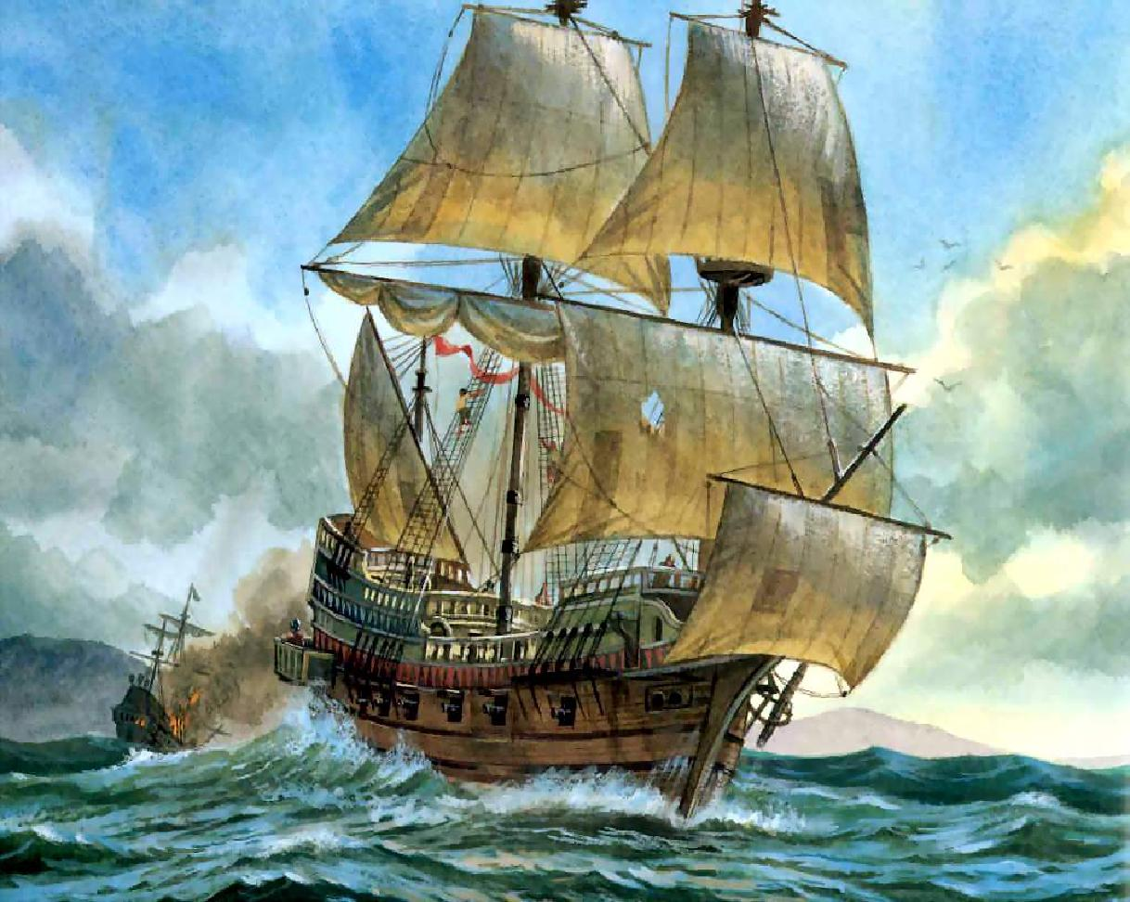
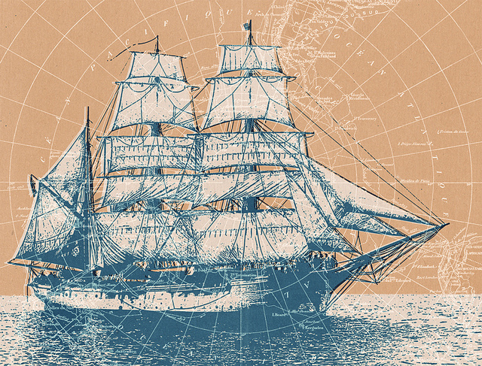
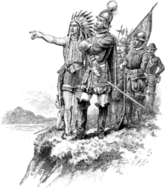
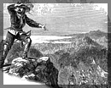
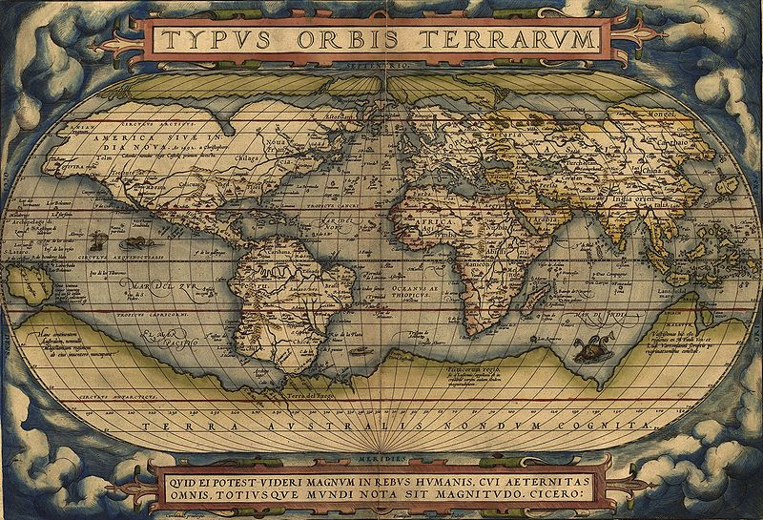
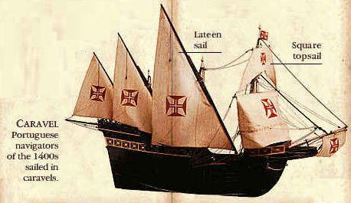
The Age of Exploration
Ryan Schwartz

Slide 2
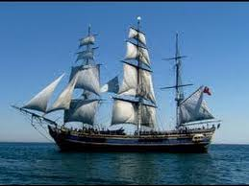
Reasons for Exploration
The purpose of the age of exploration was to find new natural resources for use by Europe’s nations and increase their supplies of wealth (gold and silver).
Natural resources were mainly brought back to the home countries from foreign colonies.
Another goal of this time period was to spread the Christian faith.
Mercantilism was the main policy used during this time and is as follows –the idea that there is a defined amount of wealth in the world and a country should gain as much as they can at the expense of other countries. This can be done by increasing exports and decreasing imports as well as having the government regulating commerce.
The Main Reasons Countries Explored:
Economic- to gain wealth for themselves (bullion)
Political-imperialism
Religious- to spread Christianity, like the Crusades
To gain a trade monopoly in Asia
Myths of treasure
Nao (exploration vessel)
Why Explorers Went:
Wealth- promise of payment from their discoveries as well as myths of foreign wealth
Family- some rights of payment extended to decedents
Titles- given as rewards: could move up a family’s social status
Learn more about foreign lands
Explorations Financed by:
King or man of high status
Merchants
Investers
Find natural resources for u at home
Procure new sources of gold and silver
Spread the Christian faith
Bypass the Ottoman Empire’s control on the spice trade from the Orient
Spanish Bullion

Slide 3
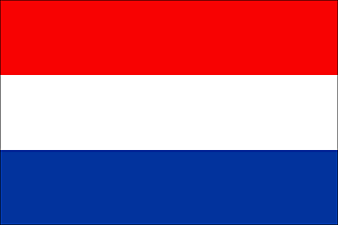
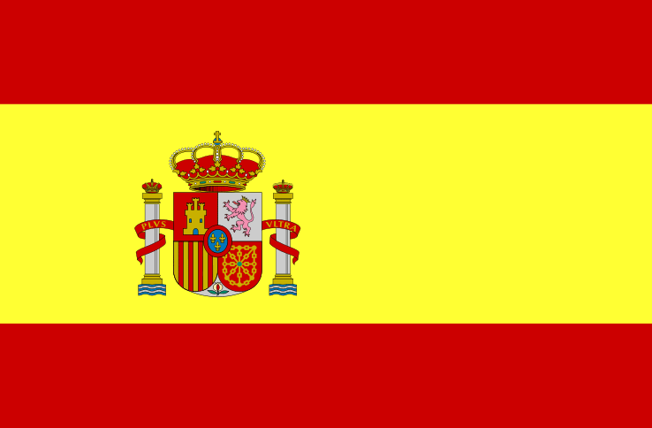
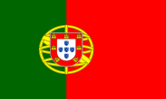
Timeline of Explorers
Ferdinand Magellan
1480-1521
(Portuguese)
Prince Henry “the Navigator”
1394-1460
(Portuguese)
Samuel de Champlain
(1567-1635)
(French)
Captain James Cook
1728 – 1779
(English)
Sponsor of Expedition
Christopher Columbus
1451-1506
(Genoa)
Sir Walter Raleigh
1554 – 1618
(English)
Henry Hudson
1565-1611
(English)
- Spain
-England
- Great Britain
- Portugal
-Netherlands
-France
Francisco Pizarro
1474 – 1541
(Spanish)
Henry Hudson
1565-1611
(English)
(Before 1747)
(After 1747)
1800
1300
1400
1500
1600
1700
1250
1350
1450
1550
1650
1750
This timeline tells the name and lifetime of each explorer or navigator. The flag attached to their box shows the country that they sailed for. The key shows the country and their corresponding flag.
Vasco Nuñez
de Balboa
1475-1519
(Spanish)
Louis Joliet
1645 - 1700
(Canadian)
Bartolemue Dias
1457-1500
(Portuguese)
Sir Francis Drake
1545-1596
(English)
Abel Tasman
1603 – 1659
(Dutch)
Vasco de Gama
1460-1524
(Portuguese)
Sebastian del Cano
1476-1526
(Spanish)
Father Marquette
1637 – 1675
(French)
Notes:
Draw dotted lines to the times each sailed
Put other peeps on timeline

Slide 4
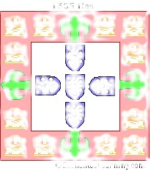
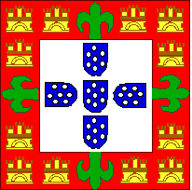
Portuguese Exploration
The Portuguese needed improved agricultural prospects than what they had in their own country, so they set out to foreign places of the world to get what they needed. They also were looking for converts to Christianity as well as to know what was out their. Out of all the countries that participated in the Age of Exploration, the Portuguese were the most secretive and advanced in their methods of navigation, leading the way for the rest of Europe.
Portugal only solely dependent on its sea power and imported many luxury items from the Orient such as spices and porcelain. This dramatically increased the wealth of Portugal during this time and made it a major European power on the seas.
The list of explores for Portugal are as follows:
Poor farm land, forced them to import food. Find food source somewhere else.
Developed advanced methods of navigation.
Became very secretive about their plans and methods.
Led the way in early exploration for the rest of Europe to follow
First to successfully mount cannons to ships.
Arranged ships in squadron for tactical advantage.
Exploration dramatically increased Portugal’s wealth.
Their success led to competition and fighting for trade routes and ports with other nations.
Explorers are as follows:
Prince Henry the Navigator
Vasco de Gama
Bartholomeu Dias
Click HERE for a brief synopsis of Portugal and its explorers.

Slide 5
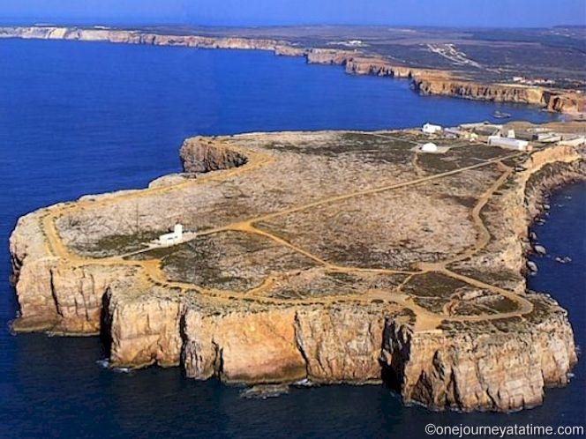
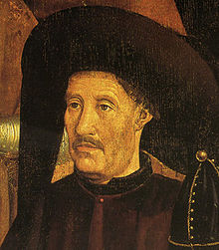
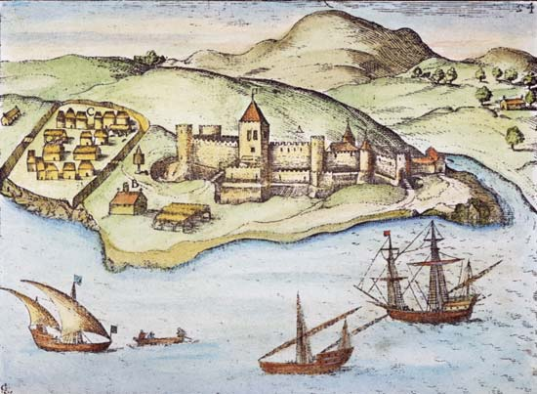
Prince Henry “the Navigator”
The location of Prince Henry “the Navigator’s” school
One of Henry’s trading posts
His main goal was to reach India and the Orient by going around Africa, but he had difficulty getting sailors to sail around a part of Africa known as Cape Bojador, the place where the Earth is closest to the sun. He never found India. Eventually, he helped establish a system of trading outposts along the African coast that helped future explorers find their way to India. These outposts supplied Portugal with slaves, ivory, and most importantly gold.
He was the son of King João I of Portugal and lived from 1394-1460. He helped Portugal take back its long hold on the Northern African lands from the Moors.
He was a mapmaker and wanted to know what was outside the sphere of Europe. In addition, he wanted converts to Christianity and discover the abode of Prester John, a Christian Kingdom that was hidden somewhere in Africa or Asia. Henry also wanted to gain wealth for his nation because most of Europe was running by the mercantilist system and his country needed the most wealth to be the best.
Set up trading posts on the western coast of Africa.
Brought slaves, ivory, and gold to Portugal.
(1394-1460)
Son of King João I of Portugal.
Mapmaker.
Sent explorers to find the Christian kingdom of Prester John and accumulate gold and riches for Portugal.
Overcame superstitions about Cape Bojador by sending Gil Eannes in 1434.
Established a school of navigation in 1418 in Sarges, Portugal.
Responsible for innovations such as the Caravel ship and celestial navigation.
Click HERE for a Minute History on Prince Henry and Portugal.
Eannes’ Route
Notes:
Change pic of school to map or something
Take out the last date because not sure

Slide 6
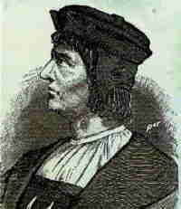
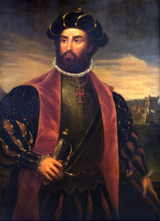
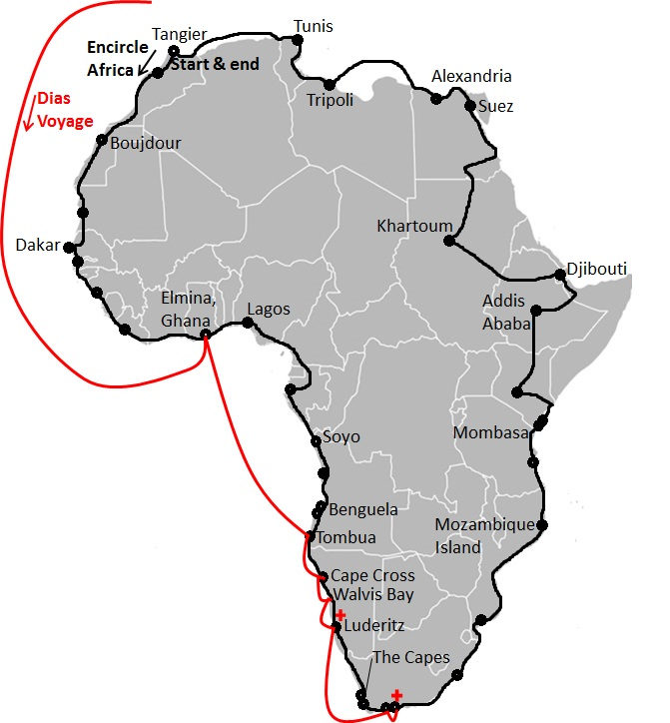
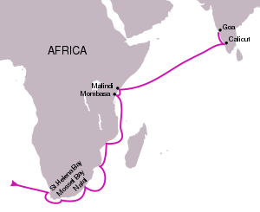
Bartolemeu Dias
Vasco de Gama
Vasco de Gama was born in 1460 in Portugal and became a member of the royal court.
He was chosen to go to India with four ships: São Gabriel, Berrio, São Raphael, and a ship for storage. Along with his brother, they ventured down Africa and past the Cape of Good Hope, northeast to India, stopping at Mozambique, Malindi, and meeting many new cultures, which were logged and accounted for, including the Hindus.
When they returned to Portugal , the price of spices had dramatically increased thanks to Venice and its monopoly on trade to the Orient. De Gama had carried boatloads of spices (spices, jewels, ivory, and gold) back with him, giving a lot of money to the Portuguese government as well as the stimulating idea of taking over the spice trade from Venice.
He also accompanied many explorers on voyages to numerous places. He went with Vasco de Gama to India, Pedro Alvares Cabral on the expedition that lead him to Brazil (on the aforementioned page), and Diogo d'Azambuja to explore the Gold Coast of Africa.
He died in 1500 in a vicious storm off the Cape of Good Hope.
Bartolemue Dias was born in Portugal in 1457 into a noble family, and was well educated from an early age.
In his later years, he was sent by King João I of Portugal to sail around the southern-most point of Africa and make contact with Prester John, the leader of a Christian kingdom in Africa or Asia which Prince Henry the Navigator desperately wanted to find. On returning back to Portugal, Dias told the King that he had meet Prester John, King of Ethiopia.
During this voyage, Dias discovered the Cape of Good Hope, the southern-most point of Africa. He called it the Cabo Tormentosa, or the Cape of Storms, because he sailed around the Cape of Good Hope during a violent storm.
Dias’ Route
The Orient (also known as the Indies) referred to the continents of Africa and Asia from which many exports came into Europe.
Click HERE for interactive visuals of the tides and currents that made these two explorer’s journeys.
Gama’s Route
(1457-1500)
Sent by King João II of Portugal to find a Christian kingdom of Prester John in 1478-88. Eventually, after Dias’ lifetime, Prester John, the King of Ethiopia, was found.
Discovered the Cabo Tormentosa in 1488, later renamed the Cape of Good Hope.
(1460-1524)
First to circumnavigate Africa and reach the Orient by water in 1498.
Allowed Portugal to take over the spice trade from the Ottoman Empire.
This was accomplished easily because Venice was at war with the Ottoman Empire. Pedro Alvares Cabral took control of this assignment, as well as discovering Brazil, while De Gama was sent back to India on another successful mission and became part of King John III of Portugal’s court. De Gama was later sent back to India to be Viceroy and died there in Cochin in 1524
Notes:
Get rid of definition ‘/,
Make maps less bold ‘/,

Slide 7
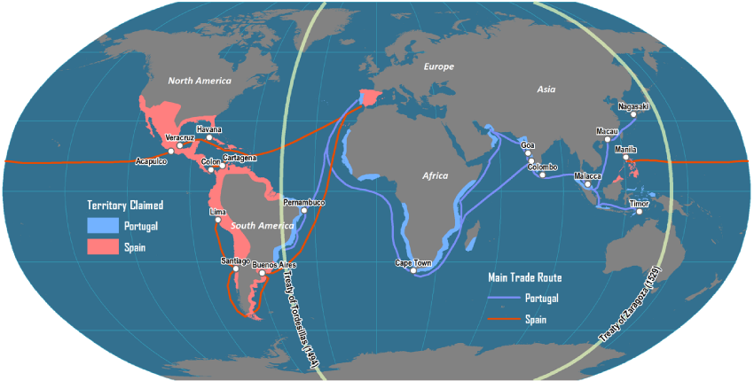
The Treaty of Tordesillas
This treaty was put into place in 1494 after the Portuguese and Spaniards had been fighting against one another for their trade routes. This treaty, put in place by the Pope, divided the world into two spheres, three-hundred miles west of the Azores, and everything to the west was Spain’s while everything to the east was Portugal's. This allowed each to keep their current landholdings and avoid deadly confrontations. The treaty was followed for many years but was later ignored by expanding European empires.
The Pope put this treaty in place in 1494, dividing the world.
The western side belonged to Spain and the eastern side to Portugal.
Eventually the Treaty was broken.
Notes:
Make description smaller
Make keys black baking (Frame) ‘/,

Slide 8
Spanish Exploration
Began looking for Atlantic Route to the east
Focused more on new found land
Wanted to create plantations and exploit mineral and agricultural riches of lands
Used indigenous people as slave labor
Used conquistadors, to establish trade routes and conquer territories
Conquered and destroyed the Aztec and Incan civilizations
Gained power through exploration
Their explorers are as follows:
Spain gain much of its power in the same way the Portuguese did, through exploration. They, however, focused less on trading and more on the new found Americas that lie on the other side of the Atlantic. This all started with Christopher Columbus and his accidental discovery.
The Spaniards conquered the native people with conquistadors in search of riches and glory. Some of the conquistadors were Hernando Cortez who conquered the Aztecs and Mayans in Mexico, starting in 1519, while Francisco Pizzaro conquered the Incans in Peru.
Many other explorers came from Spain to discover the rest of the world and are listed below:
Christopher Columbus
Ferdinand Magellan
Vasco Nuñez de Balboa
Sebastian del Cano
Francisco Pizzaro

Slide 9
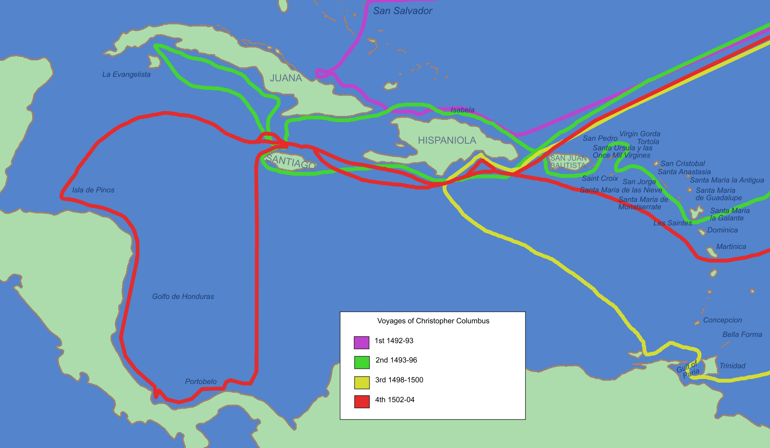
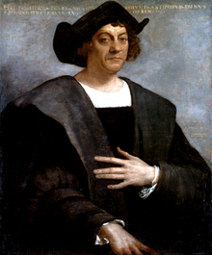
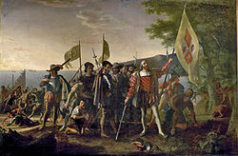
Christopher Columbus
Christopher Columbus was born in 1451 in the Republic of Genoa, Italy and was surrounded by the sea, giving him a desire to discover what was beyond. He was educated late in his life and went to Portugal to fulfill his aspirations and receive a charter from the government. He was rejected.
He then went to Queen Isabelle I and King Ferdinand V of Castille for a charter but was declined again. Then, after the Moors were defeated at Granada, young nobles called hidalgos expected land in return for their services. So, with the help of an adviser named Santángel, Christopher Columbus’ mission, now to gain new land abroad for the numerous hidalgos, was approved in 1492.
Columbus thought he could also find a new route to India on his voyage by going west of the Canary Islands. As he set out on his journey, he was given a fleet of three ships consisting of the Niña (also called the Santa Clara), the Pinta, and the Santa María.
He landed on the island of Hispaniola after sixty-six days at sea. He thought that he had discovered the Orient and was astonished to see such interesting natives. During his voyage, he also discovered the island of San Salvador (Walting Island), the island of Santa Maria de la Concepcion (also known as Rum Cay), the Island of Fernandina (Long Island, Ney York), the island Isabella (Crooked Island), Cuba, also called Juana (named after Spain’s young Prince), the island of Hispaniola, the island of Haiti, and the island of San Domingo. During the last part of this voyage, the ship Santa María sunk.
Columbus had three other voyages, which involved converting the locals to Christianity across the Atlantic that resulted in the discovery of the islands of Montserrat, San Martin, Santa Cruz ,Antigua, and the Virgin Islands, and San Juan Bautista (Puerto Rico).
During these voyages, Columbus started the Spanish tradition of abusing and interacting with the inhabitants of their colonies.
Columbus died in 1506.
Diagram of Columbus’ Voyages
(1451-1506)
Born and raised in Genoa.
Explorer for Spain after being rejected by Portugal.
Sent in 1492 to discover a westward passage to the Orient.
He sailed a total of four voyages (see map).
Founded colonies, bringing great wealth to Spain.
Established tradition of mistreating the native people.
Click below for a documentary on Columbus.
Part 1 Part 2 Part 3 Part 4 Part 5 Part 6 Part 7 Part 8 Part 9
Part 10
Columbus Discovers Jamaica
Notes:
Delete part 2-10 ‘/,
Delete lower map ‘/,

Slide 10
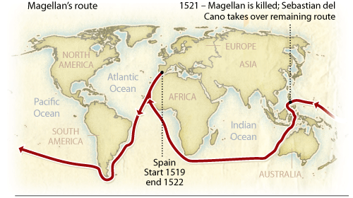
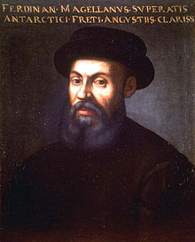
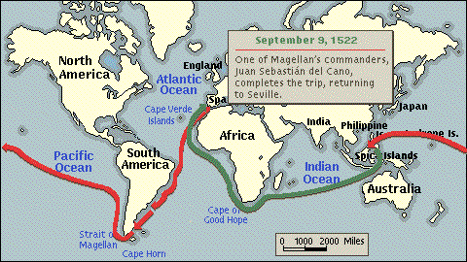
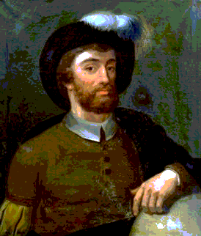
Ferdinand Magellan
During this journey, starting in 1519, Magellan traveled down the eastern coast of South America and reached a strait near the very bottom, passed through it, and named it after himself, the Strait of Magellan. He also named the ocean that lied beyond it which Captain Balboa found, the Pacific Ocean. It was named this because of its calm waters. Mutinies occurred during this time as well a scurvy, killing many crew member onboard. Later, they reached Guam, Moluccas, and the Philippines where Magellan died in 1521 from a war between his crew and the natives, ending up with a poison arrow in his foot and a spear through his heart.
Sebastian del Cano, a member of the crew left after Magellan died, finished the journey and returned to Spain, going through the Indian Ocean, around the Cape of Good Hope, and up the western side of Africa. In Spain, he is remembered as the first man to circumnavigate the globe while in the rest of the world, since many of the European countries hated Spain, like England, said that Magellan was the first man to circumnavigate the globe.
Ferdinand Magellan, born in 1480 in northern Portugal, was raised around the talk of fabulous explorers and amazing discoveries, making him want to see the world. He did this by fighting in the battle of Malacca and Morocco for the Portuguese and sailing with them on a journey to conquer Melaka and seek the Spice Islands.
After being kicked out of Portugal, he joined a monastery and began to study the arts of exploration: charts, pilots’ logs, and maps. He later presented an idea of finding a route to the Indies through the New World to King Charles I of Spain, who enthusiastically agreed. He was given five ships called the Santiago, the Conception, the San Antonio, the Victoria, and the Trinidad. He would also be given the title of governor to any new lands that he found on his way.
globe.
Their
Route
Sebastian del Cano
Sebastian del Cano, a member of the crew, took command of the ship and sailed it back to Spain in 1522.
He was the first man to circumnavigate the globe.
England hated the Spanish, naming Magellan the first to circumnavigate the globe instead of Del Cano.
(1480-1521)
He was a Portuguese man expelled from Portugal
Knowledgeable in the art of navigation
Hired by Spain in 1519.
Charles I of Spain sent him to find a passage to the Orient through the new world.
Found and navigated the Strait of Magellan.
Killed in the Philippines by a poison arrow to the heart in 1521.
Click HERE for a detailed animation on the voyage of these two explorers.
(1476-1526)

Slide 11
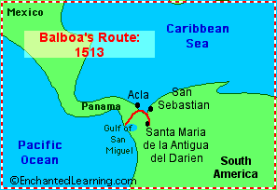
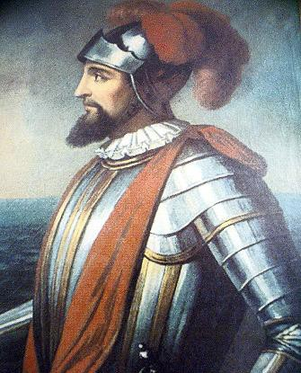
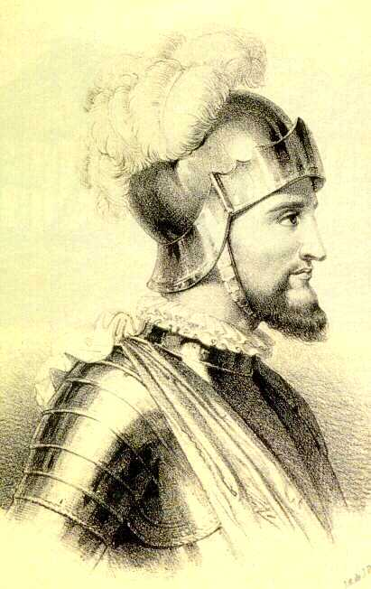
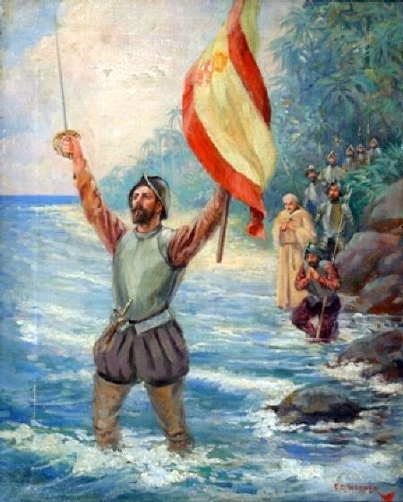
Vasco Nuñez de Balboa
Balboa Discovers the Pacific
(1475-1519)
Explorer and conquistador.
Founded a colony in South America called Santa María de la Antigua del Darién after wandering in the Caribbean for ten years in 1511.
Discovered the Pacific Ocean in 1513 by crossing the Isthmus of Panama.
The Pacific Ocean was named the South Sea by Balboa, and the Pacific Ocean by Magellan.

Slide 12
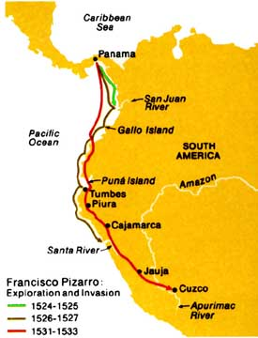
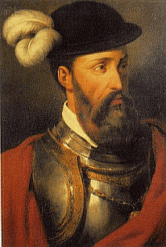
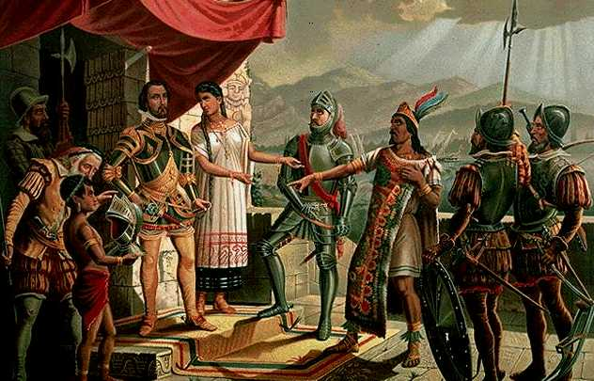
Francisco Pizzaro
Click HERE for the first part of a background on Pizarro’s conquering of the Incan Empire. Click HERE for part two.
(1474-1541)
He was a Spanish conquistador that conquered the Incan Empire in Peru and Chile in 1532.
Helped Balboa discover the Pacific Ocean.
Pizarro was financially helped by the Holy Roman Emperor Charles V (Carlos I of Spain).
Both were attracted by the gold and riches the land held.
A conquistador is a conqueror of the native civilizations of Mexico and Peru.
Francisco Pizzaro, born in 1475 to an army officer, was a shipmate with Captain Balboa as he discovered the Pacific Ocean after crossing the Isthmus of Panama. He stayed in Panama until the allure of riches in South America tempted him to go there.
He tried and failed two times then, with the help of Charles V, Holy Roman Emperor, he set sail, once again, to conquer.
Pizzaro marched to the Incan city of Tumbes, which was in rubbles from a recent war, and was easily taken over. In a short time, all of Peru was under his grasp and he moved towards Chile and its gold. His ally, Diego Almargo, conquered the city of Cuzco, the Incan capital, and enraged Pizzaro in the process. Pizzaro had Almargo executed and was then killed by Almargo’s son for revenge in 1541.
Pizzaro’s Expeditions
Pizzaro and the Incan Emperor
Notes:
Find out who Pizzaro conquered the Incan’s for (Spain or HRE) ‘/,

Slide 13
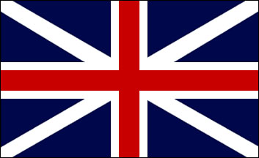
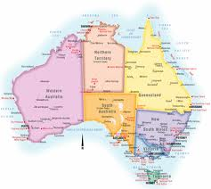
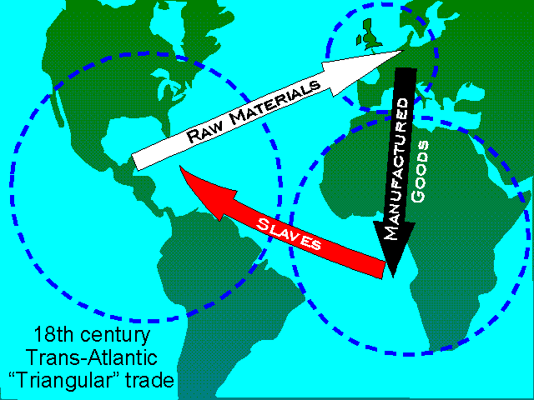
English Exploration
The largest empire in Europe and they wanted to keep expanding.
American colonies provided natural resources.
Triangular slave trade between the American colonies, Europe, and Africa.
Australia used as a prison colony for the jail overflow.
Widespread exchange of animals, plants, culture, human population, and diseases influenced ways of life (Columbian Exchange).
Their explorers are as follows:
England had a vast array of colonies from the Pacific to Atlantic, making it the largest Empire in the world. England’s largest and most prominent colonies were the American colonies and Australia. The American colonies were used for their natural resources and ability to produce large amounts of food. England has a long history of banishing religious groups, such as the Mormons and the Amish. It also largely participated in the triangular slave trade. This involves competed products exported from Europe and being shipped to Africa. It is exchanged their for slaves who are shipped of to the American colonies who exchange them for raw materials which get shipped off to Europe. Then the cycle starts again. This was a part of the Columbian Exchange, in which Europe and the New World exchanged not only goods and customs but diseases as well.
Australia was a prison island that was used to banish prisoners out of the overflowing jails. This was its only real purpose and Australia did not supply England with many resources.
There are many explorers who discovered new lands, allowing England and later Great Britain to grow to its enormous size. Some of the explorers are listed below:
Sir Francis Drake
Henry Hudson
Sir Walter Raleigh
Captain James Cook

Slide 14
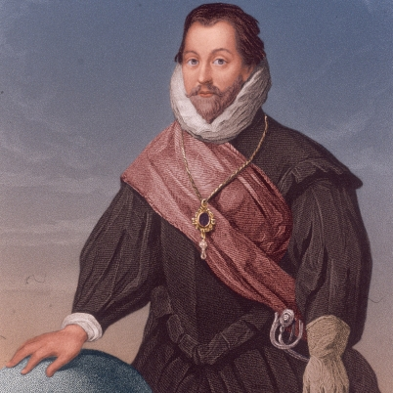
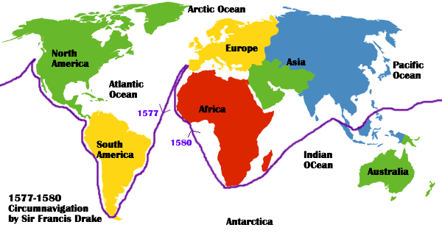
Sir Francis Drake
Sir Francis Drake helped defeat the Spanish Armada, a fleet of 170 Spanish ships sent in 1588 against England in response to it’s interference in Spain’s slave trade. The Armada was defeated by a combination of the English and a violent storm, thus opening the Americas to other countries.
Sir Francis Drake, born in 1545 in England, was the first Englishman and second European to circumnavigate the globe. He took a different route than Magellan and del Cano because he went all the way up the west coast of North America to California or Vancouver and founded the colony of Nova Albion for Queen Elizabeth I. Its location was a secret so no one know how far Drake actually went up the west coast. After that, he sailed across the Pacific, back through the Indian Ocean, and up Africa to Europe. During this endeavor, Drake pirated Spanish ships near Panama and landed on the island of Cano near Mexico.
Later in his life, Drake fought against and defeated the Spanish Armada in 1588 when he was second in command. The dispute was over the slave-trade which was very profitable for the Spanish. He was such an excellent fighter at sea that the Spanish called him “El Draque”, which means The Dragon. He died shortly after in 1596.
(1545-1596)
The first Englishman and the second European to circumnavigate the globe in 1577-80
Privateer
His route took him up the west coast of North America, where he established the colony of Nova Albion
He fought the Spanish Armada in 1588
Click HERE to watch an amazing student-made biography on Sir Francis Drake.
Drake’s Circumnavigation

Slide 15
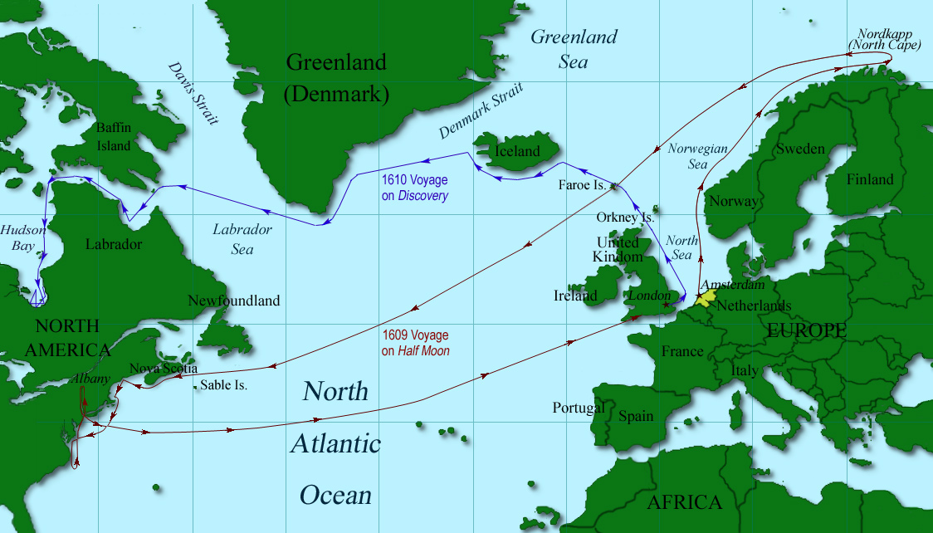
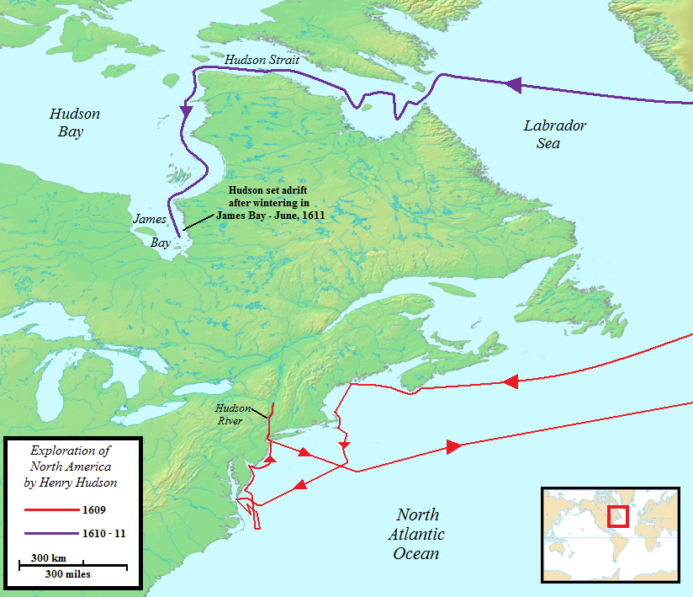
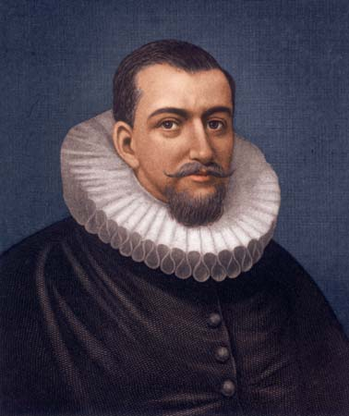
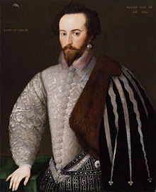
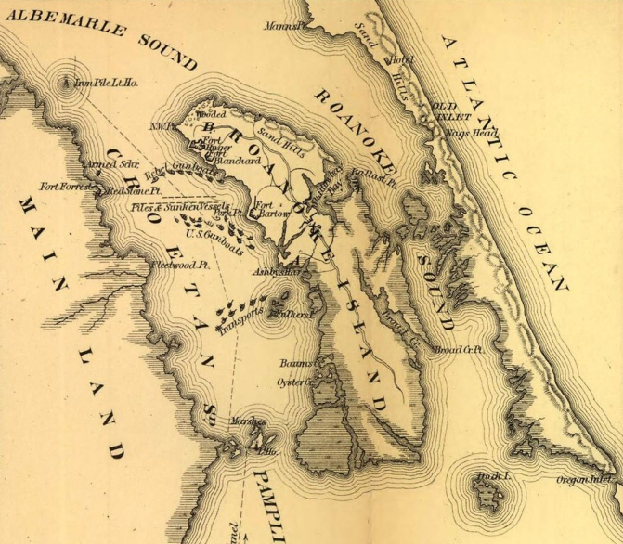
Henry Hudson
An Englishman and a favorite of Queen Elizabeth I who sent him to colonize North America at Roanoke in 1585 and 1587, both failed
Brought the potato to England from North America
Sir Walter Raleigh was born in 1554 in Hayes Barton in Devon. He was a favorite of Queen Elizabeth I and was the man who sponsored the first two attempts in colonizing North America at Roanoke. The first of the two colonies was unsuccessful and the second one was mysteriously disappeared.
His failures were slightly diminished by the discovery of the potato which he brought back with him to Ireland. This discovery greatly helped the Irish economy.
He later searched for El Dorado but was executed in 1618 when he conflicted with the Spanish after James I became King.
Born in 1565 in England, Henry Hudson was trying to find a northern passage to the Orient. He tried four times, and failed. His first try was with the Muscovy Company in 1607 which, as expected, failed due to icy conditions, but he managed to explore some of Greenland and also discovered new whale hunting territory.
On his second voyage in 1608, Hudson tried again and failed to discover the Northeastern Passage. He went as far as Novaya Zemlya, an archipelago north or Russia, before he had to turn back.
Hudson later joined the Dutch East India Company and in 1609 tried to discover the Northeastern Passage for a third time. He was, again, blocked by ice in Russia but backtracked and ended up in Nova Scotia.
On his last and final journey 1610, Hudson left from England and went to the southern-most tip of Greenland, entering a waterway later called the Hudson Strait. He then found the Hudson Bay and James Bay but came to a dead end. His crew was so mad at Hudson that they cast him adrift in the ocean, along with his son and some crew members, to die. This act of mutiny occurred in 1611.
Henry Hudson’s Voyages
The Colony of Roanoke
(1564-1611)
An Englishman who tried four times, in 1608, 1609, 1609, and 1610, to find a northern passage to the Orient
Explored many parts of Greenland and Canada when sailing for the English in 1607 and 1608
He later sailed for the Dutch East India Company in 1609 and 1610 and explored a large portion of the Hudson Bay and its many connecting waterways
Sir Walter Raleigh
(1554-1618)
Notes:
Add notations for pictures

Slide 16
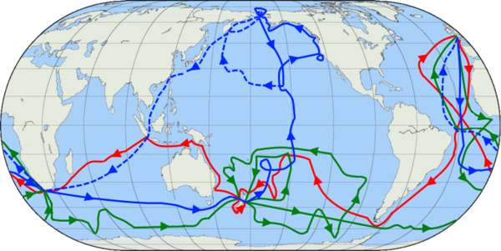
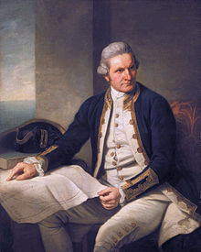
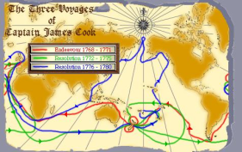
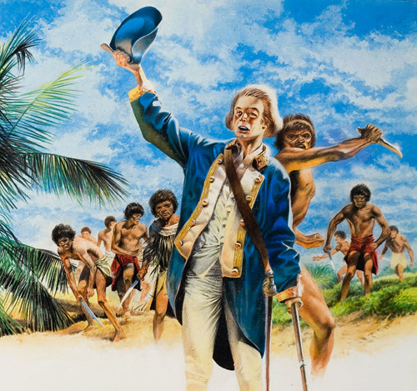
Captain James Cook
Captain James Cook, born in 1728 in Marton-in-Cleveland, England, joined the Royal Navy His third and final journey was in search of a northwestern passage in which he discovered the Sandwich Islands (Hawaiian Islands). Cook noticed that all of the different Polynesian islands had many cultural and lingual characteristics that were similar. He then went to the western coast of North America looking for the northwest passage but returned to the Sandwich Islands for repairs. There, Cook was killed by the once friendly natives in 1779.
His second voyage lead him through the Antarctic Circle. This allowed him to theorize the existence of Antarctica. Cook also discovered the islands of Tonga, New Hebrides, Easter Island, and the Cook Islands.
His third and final journey was in search of a northwestern passage in which he discovered the Sandwich Islands (Hawaiian Islands). Cook noticed that all of the different Polynesian islands had many cultural and lingual characteristics that were similar. He then went to the western coast of North America looking for the northwest passage but returned to the Sandwich Islands for repairs. There, Cook was killed by the once friendly natives in 1779.
(1768-1771)
(1772-1775)
(1776-1779)
Cook’s Voyages
Cook’s Death
(1728-1779)
Member of the Royal Navy and the Royal Society of London, who gave him the task of studying Venus at sea in 1768.
During initial voyage found cure for scurvy by eating fruits and vegetables.
Circumnavigated islands of New Zealand and the strait that divided them (the Cook Strait).
Finished expedition by sailing around the Cape of Good Hope, circumnavigating the globe.
Second voyage led him into the Antarctic Circle in 1772.
This allowed him to theorize the existence of Antarctica.
Found Tonga, New Hebrides, Easter Island, and the Cook Islands.
Discovered Sandwich Islands (Hawaiian Islands) on his final voyage in 1776.
Made the connection between the different Polynesian Languages and cultures.
Killed by the native Hawaiians in 1779.

Slide 17
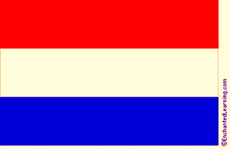
Dutch Exploration
In 1600, the Dutch had more ships than any other nation.
Encouraged privateers to prey on poorly defended Spanish and Portuguese ships.
In 1602, the Dutch East India Company was created and found a route to Asia, occupying unclaimed lands.
Pushed French and English out of Indonesia.
In 1614, the New Netherlands Company created to occupy lands in North America between New France and English Virginia.
In 1621, Dutch West India Company began trading with West Africa and the Western Hemisphere.
Began settling in Delaware, Connecticut, and along the Hudson River.
In 1634, the Dutch seized the Spanish possessions in the West Indies (the Caribbean).
One of their explorers is listed below:
Able Tasman
Henry Hudson (shown under England)

Slide 18
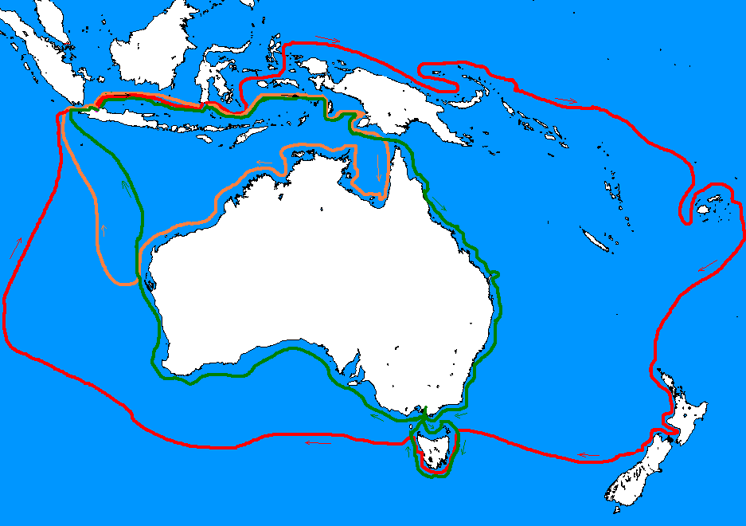
Abel Tasman
Dutch
Abel Tasman was born in Lutjegast, Gröningen in 1603 and became part of the Dutch East India Company in his late twenties. He quickly rose up in the ranks. He was then assigned to explore the mass continent Terra Australis Incognita, or the Great South Land, and find routes for trade with China and Chile.
During this voyage, in 1642, Tasman discovered the southern Australian island of Van Diemen’s Land (Tasmania), which he claimed for the Dutch East India Company, New Zealand, where he was attacked by native Maori islanders and mistook it for South America, the small island of Tonga, and the first European to see the Fiji Islands. This mission was considered a failure because no new trade connections were established.
On his second journey, in 1643, Tasman was assigned to discover if New Guinea was part of Great South Land. When he ventured out to uncover the truth, he completely missed the Torres Strait that splits the two and called them one giant land mass.
He died in Batavia in 1659.
Tasman's Expeditions
(1603-1659)
Worked for the Dutch East India Company.
Sent to explore the mass continent of Terra Australis Incongnita and establish trade relations with China and Chile in 1642.
Discovered the islands of Tasmania, New Zealand (and its violent Maori inhabitants), Tonga, and Fiji in 1642
He did not establish any trade connections.
Second voyage in 1643 to see if New Guinea and Terra Australis Incongnita were connected.
Missed the Torres Strait that divided them and said they were one.
1642
1643
Tasmania

Slide 19
French Exploration
They wanted to increase the size of their empire, making it even larger than England’s.
As a highly religious country, one of their goals was to spread Christianity.
They wanted spices and riches, like the ones from the orient, but looked for them in the west instead of the east.
Fur was very popular in France and in high demand. They looked for new sources of fur.
Their explorers are as follows:
Father Marquette
Louis Joliet
Samuel de Champlain

Slide 20
Father Marquette
Samuel de Champlain
&
Louis Joliet
Marquette and Joliet Exploring the Mississippi
(1637 – 1675)
(1645 - 1700)
(1567-1635)
French (Marquette) and Canadian (Joliet) explorers.
Father Marquette was a Jesuit priest.
They discovered the Mississippi River in 1673, hoping to find a river connecting the Pacific and Atlantic Oceans.
Father Marquette also made it his goal to convert the native indians to Christianity.
Marquette started a colony in Illinois that later became Chicago in 1674.
French explorer.
Sailed and Recorded most of Nova Scotia in 1604-07.
Established a fur trading center in Quebec in 1608.
Explored the Great Lakes and Discovered Lake Champlain in 1609.
Marquette, Joliet, and Champlain’s Routes

Slide 21
Ships of the Age
Caravel
One ship of this time period was called a caravel, which had a firm rudder for good control and was slim for nimbleness. The boat itself is shallow so that it can sail around coastal waters without running aground. It could be controlled with twenty-five men and could interchange its triangular sails for square sails, allowing it to maneuver better in storms and have good speed in between winds. This version was called the caravela redonda, the ship that the Portuguese bragged about having in their fleet.
Invented by Prince Henry “the Navigator” at his navigation school and a favorite among the Portuguese
Strong rudder for good maneuverability
Shallow hull (six foot depth) for sailing coastal waters
Operated by a small crew (25 men)
Could interchange square sails for triangular ones, allowing greater mobility in storms
Fastest of its time
The next ship of the age was called a nao. This specific ship has square sails, allowing for better maneuverability in storms and faster speeds when no winds are present. It is a larger ship so that it can carry more supplies for longer journeys and has a deeper hull for greater stability in the open ocean. Its also has three masts for better wind control in hectic storms. This ships was very popular during the age of exploration. All of Magellan’s fleet was comprised of naos ships.
Nao
Square sails allowed for faster speed with little wind
Larger hull allowed for more storage and longer journeys
Deeper hull gave greater stability to the boat in the open ocean
Three large masts gave the ship better control of the wind in storms
Magellan's fleet was comprised of these ships

Slide 22
Inventions
Advancements in the field of navigation helped explorers find their way.
Astrolabe
Measured latitude while sailing, determines your position north or south of the equator.
Measured the angle between the horizon and a celestial body, like he North Star.
Go to a chart called a ephemeris and find the parallel that corresponds with the specific celestial body on a specific day.
Compass
Only instruments that pointed in a northward direction, not exact locations for navigators.
Old compasses were made out of a magnetized iron needle.
They later evolved into a painted disk with directional arrows with a rotating brass pin.
Calculating Longitude
It involved determining the speed of the ship, compass direction, and time of day.
Speed was measured by how fast a piece of wood would float to the end of the ship from the bow.
Time was taken with using sundials and hour glasses.
Astrolabe
Hourglass

Slide 23
Works Cited
http://www.infoplease.com/biography/var/bartolomeudias.html
http://www.thenagain.info/webchron/westeurope/dagama.html
http://www.enchantedlearning.com/explorers/page/h/henry.shtml
http://www.enchantedlearning.com/explorers/page/c/champlain.shtml
http://www.enchantedlearning.com/explorers/indexm.shtml
http://www.elizabethan-era.org.uk/louis-joliet.htm
http://learningtogive.org/papers/paper272.html
http://www.mce.k12tn.net/explorers/frenchexplorers.htm
Allen, Oliver E. The Pacific Navigators. Alexandria, VA: Time-Life, 1980. Print.
"Bartholomue Dias." Elizabethan Era. N.p., n.d. Web. 15 Dec. 2012.
"Bartolomeu Dias." Infoplease. Infoplease, n.d. Web. 8 Jan. 2013.
Buzzitta, Pat. "Marquette, Father." Learning to Give. Points of Light
Institute, n.d. Web. 10 Jan. 2013.
"Christopher Columbus." Christopher Columbus. Soylent Communications,
n.d. Web. 16 Dec. 2012.
"Explorers." EnchantedLearning.com. N.p., n.d. Web. 9 Jan. 2013.
Farrington, Karen. Historical Atlas of Expeditions. New York: Checkmark, 2000. Print.
"Henry Hudson Biography." Bio.com. A&E Networks Television, n.d. Web. 15 Dec. 2012.
Humble, Richard. The Explorers. Alexandria, VA: Time-Life, 1978. Print.
"Juan Sebastian Del Cano (Spanish Navigator)." Encyclopedia Britannica Online. Encyclopedia Britannica, n.d. Web. 15 Dec. 2012.
"Louis Joliet." Elizabethan Era. N.p., n.d. Web. 8 Jan. 2013.
"Magellan." ThinkQuest. Oracle Foundation, n.d. Web. 16 Dec. 2012.
"Prince Henry the Navigator." EnchantedLearning.com. N.p., n.d. Web. 7 Jan.
2013.
"Prince Henry the Navigator's Life." Timeline. N.p., n.d. Web. 15 Dec. 2012.
"Samuel De Champlain: Explorer." EnchantedLearning.com. N.p., n.d. Web.
9 Jan. 2013.
"Sir Francis Drake: Explorer." EnchantedLearning.com. N.p., n.d. Web. 16 Dec. 2012.
"The French Come to the New World." Explorers. N.p., n.d. Web. 10
Jan.2013.
"Vasco Da Gama." ThinkQuest. Oracle Foundation, n.d. Web. 16 Dec. 2012.
Mejiak, Michelle. "Vasco Da Gama Arrives in India." World History
Cronology.Ed. Dana Thompson. N.p., 15 Dec. 1998. Web. 8 Jan. 2013.

